Slide 1
EC3357:Machine Learning
Lecture 4B: Multinomial Logistic Regression

Slide 2
What is Multinomial Logistic Regression?
Multinomial Logistic Regression is the regression analysis to conduct when the dependent variable is nominal with more than two levels.
It is an extension of logistic regression that adds native support for multi-class classification problems.
Binomial Logistic Regression:
Standard logistic regression that predicts a binomial probability (i.e. for two classes) for each input example.
Multinomial Logistic Regression:
Modified version of logistic regression that predicts a multinomial probability (i.e. more than two classes) for each input example.

Slide 3
Example:
Assume that we observed a class of students for a whole term. At the end of the term, we gave each student a computer game as a gift for their effort. Each participant was free to choose between three games – an action, a puzzle or a sports game. We want to know how students’ scores in math, reading, and writing affect their choice of game. Note that the choice of the game is a nominal dependent variable with three levels. Therefore, multinomial regression is an appropriate analytic approach to this scenario.

Slide 4
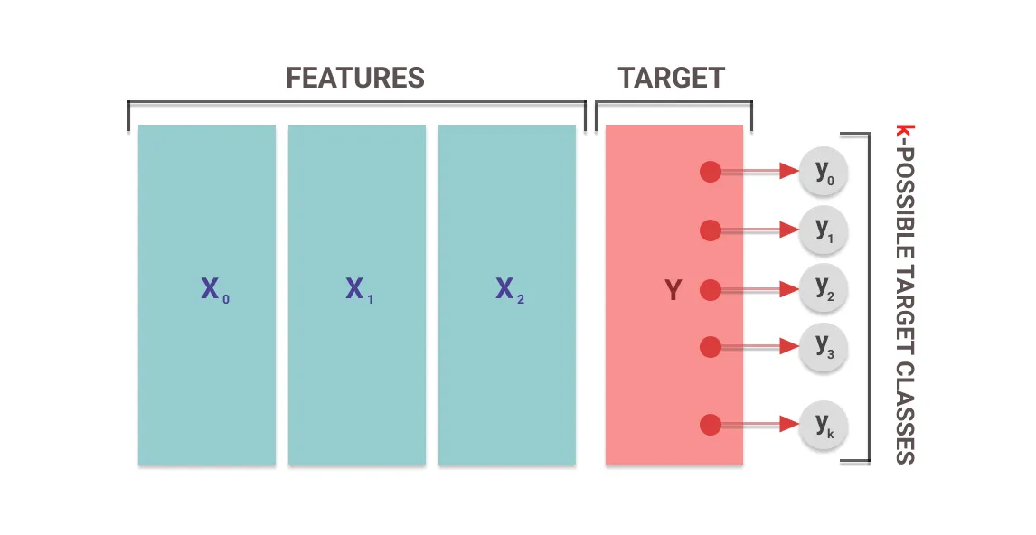
The outcome predicted for a feature set is one of the k-possible outcomes

Slide 5
How does MLR work?
The multinomial regression function is a statistical classification algorithm.
What this means is that once we feed the function a set of features, the model performs a series of mathematical operations to normalize the input values into a vector of values that follows a probability distribution.

Slide 6
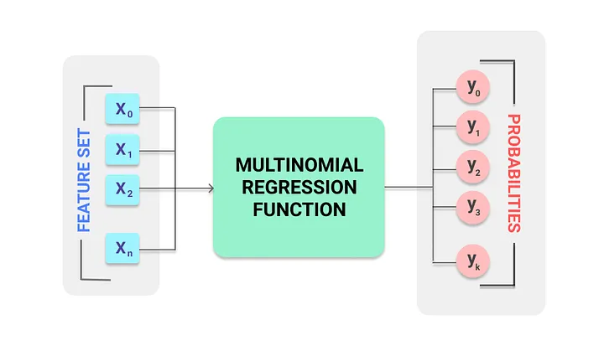
The MLR function calculates probabilities for possible target classes from the given feature set

Slide 7
Step 1: Gather your data
To start with a simple example, let’s say that your goal is to build a logistic regression model in Python in order to determine the category of employees based on salary and years of experience.
Here, there are 3 possible outcomes: Executive (represented by the value of ‘2’), managerial (represented by the value of ‘1’) and operational (represented by the value of ‘0’)

Slide 8
Step 2: Import the needed Python packages
import numpy as np
import pandas as pd
from sklearn.model_selection import train_test_split
from sklearn.preprocessing import StandardScaler
from sklearn.linear_model import LogisticRegression
from sklearn.metrics import accuracy_score, confusion_matrix, classification_report

Slide 9
Step 3: Build a dataframe
data = {
'salary': [50000, 60000, 80000, 120000, 30000, 70000, 40000, 100000, 150000, 20000],
'years_of_experience': [1, 2, 5, 10, 0.5, 3, 1.5, 7, 12, 0.2],
'category': [0, 0, 1, 2, 0, 1, 0, 1, 2, 0]
}
df = pd.DataFrame(data)
print (df)
Category is the target variable, ranging from 0 to 2

Slide 10
salary years_of_experience category
0 50000 1.0 0
1 60000 2.0 0
2 80000 5.0 1
3 120000 10.0 2
4 30000 0.5 0
5 70000 3.0 1
6 40000 1.5 0
7 100000 7.0 1
8 150000 12.0 2
9 20000 0.2 0

Slide 11
Step 4: Create the logistic regression in Python
Set the independent variables (represented as X) and the dependent variable (represented as y):
X = df[['salary', 'years_of_experience’]]
y = df['category’]
Split the dataset into training and testing sets
X_train, X_test, y_train, y_test = train_test_split(X, y, test_size=0.3, random_state=42)
Standardize features by removing the mean and scaling to unit variance
scaler = StandardScaler()
X_train = scaler.fit_transform(X_train)
X_test = scaler.transform(X_test)

Slide 12
Create and train the logistic regression model
model = LogisticRegression(multi_class='multinomial’, solver='lbfgs', max_iter=1000)
model.fit(X_train, y_train)

Slide 13
Step 5: Make predictions on the test set and evaluate the model
Make predictions on the test set
y_pred = model.predict(X_test)
Evaluate the model
accuracy = accuracy_score(y_test, y_pred)
conf_matrix = confusion_matrix(y_test, y_pred)
class_report = classification_report(y_test, y_pred)
print(f"Accuracy: {accuracy}")
print("Confusion Matrix:")
print(conf_matrix)
print("Classification Report:")
print(class_report)

Slide 14
Example prediction
new_data = np.array([[75000, 10]]) # New staff with 75,000 salary and 10 years of experience
new_data = scaler.transform(new_data)
predicted_category = model.predict(new_data)
print(f"Predicted Category for new data: {predicted_category[0]}")

